Slide 1

Week 7 CTI Task
Name: Tirth Hirenkumar Jaiswal
Student ID: 12196525
Cyber Security

Slide 2
GIT Repository
https://github.com/Tirth-7424/Week7-CTI.git
git@github.com:Tirth-7424/Week7-CTI.git
gh repo clone Tirth-7424/Week7-CTI
Tools used further in scans:
Nessus
Waf00f
Legion
Nikto

Slide 3

Set-up a shared folder in Wazuh
I set-up a folder named Wazuh2 in my host computer and after going in virtual box settings, I selected that folder as shared folder.

Slide 4
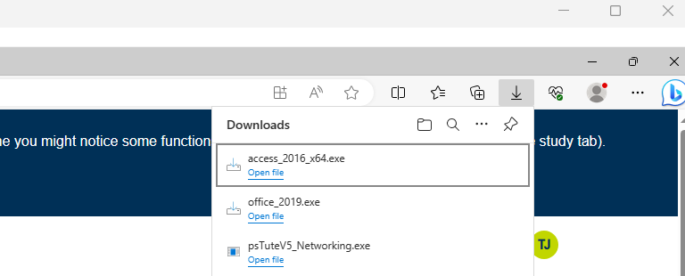
Additional Apps installed in VM
In additional apps I installed the following apps:
Office version 2019
Access version 2016

Slide 5
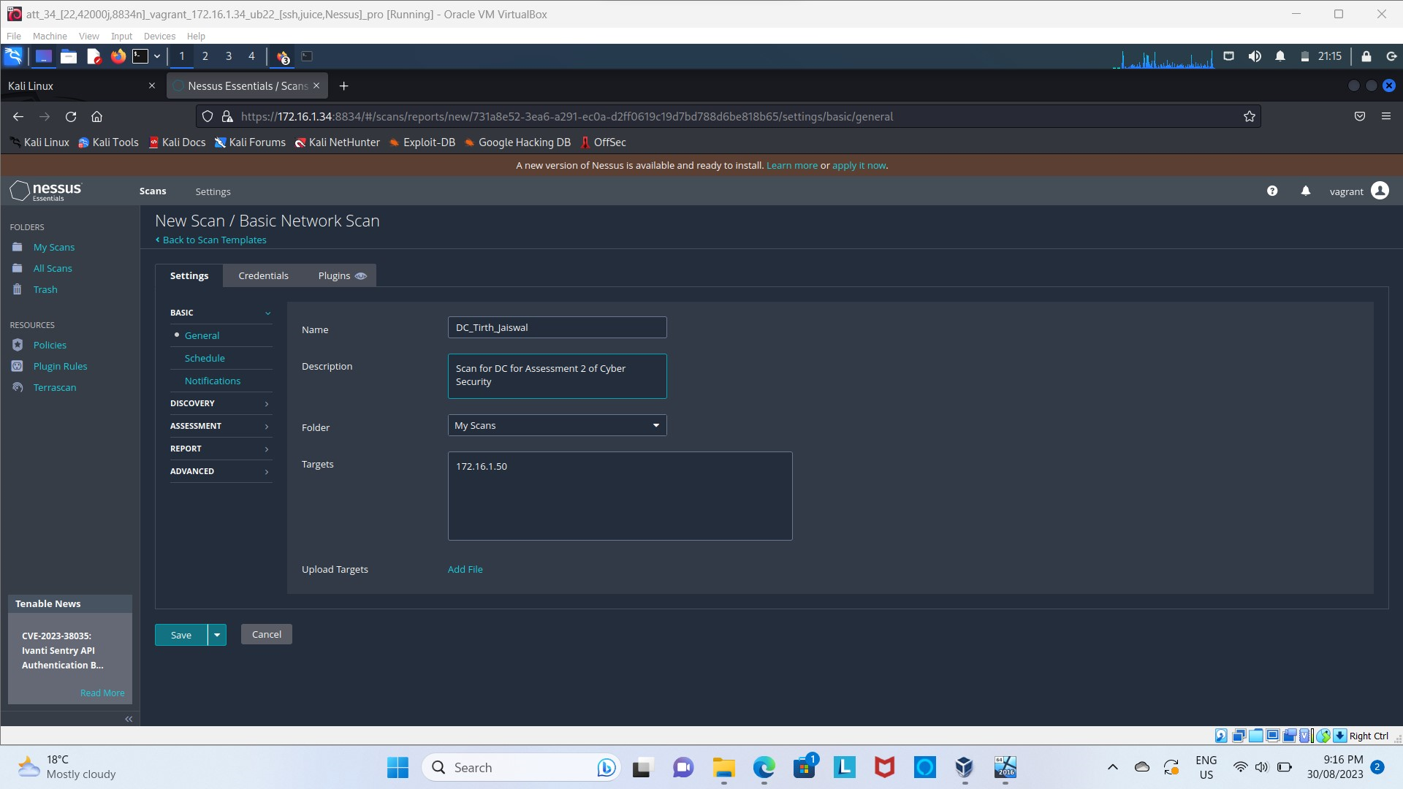
Nessus scan initiation
Here in this step I have shown how to set-up the name and how to start the basic scan.
Kali->Firefox->Nessus login->scans->basic scan->start and enter the target IP.
I found in total:
DC: 46 vulnerabilities
Odoo: 20 vulnerabilities of info

Slide 6
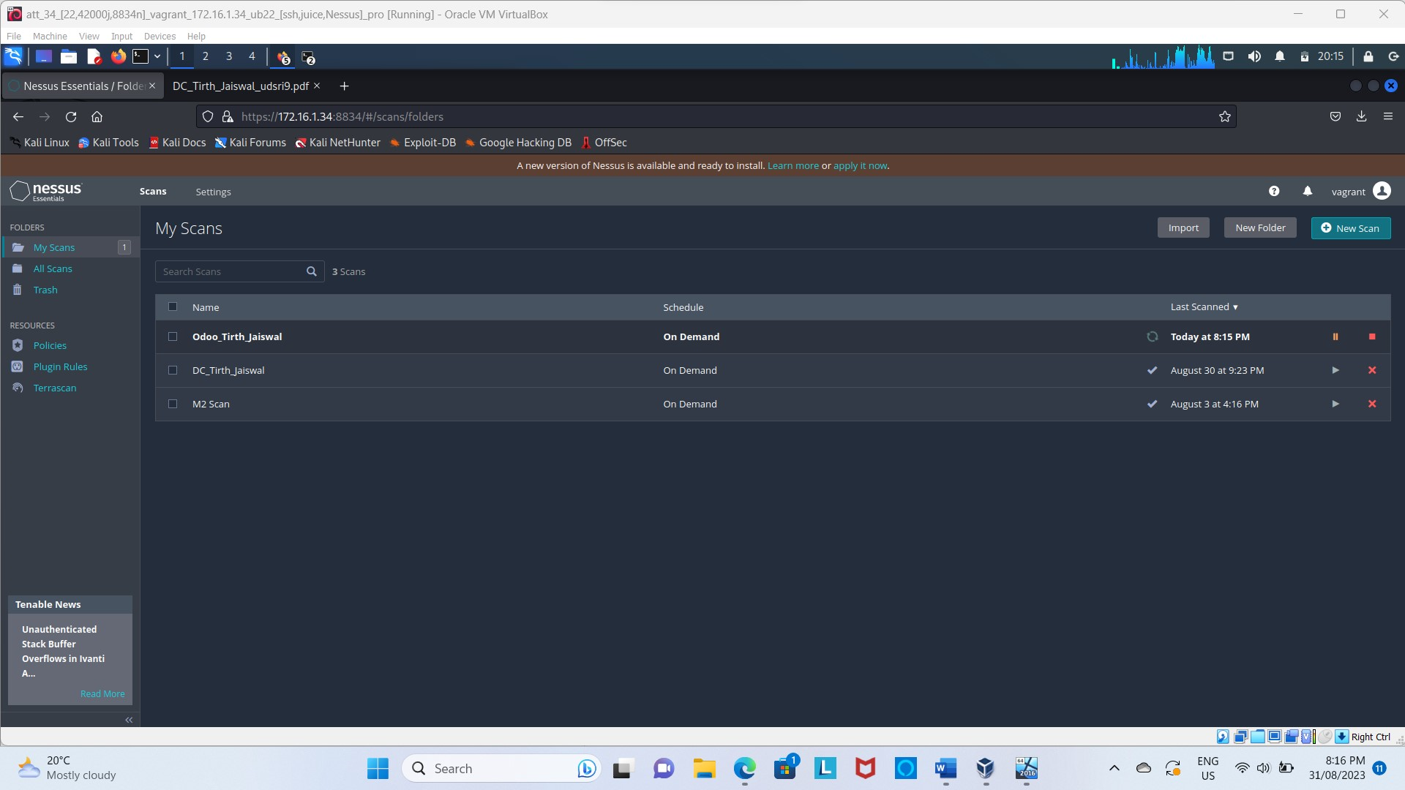
Scan completed for both VMs

Slide 7
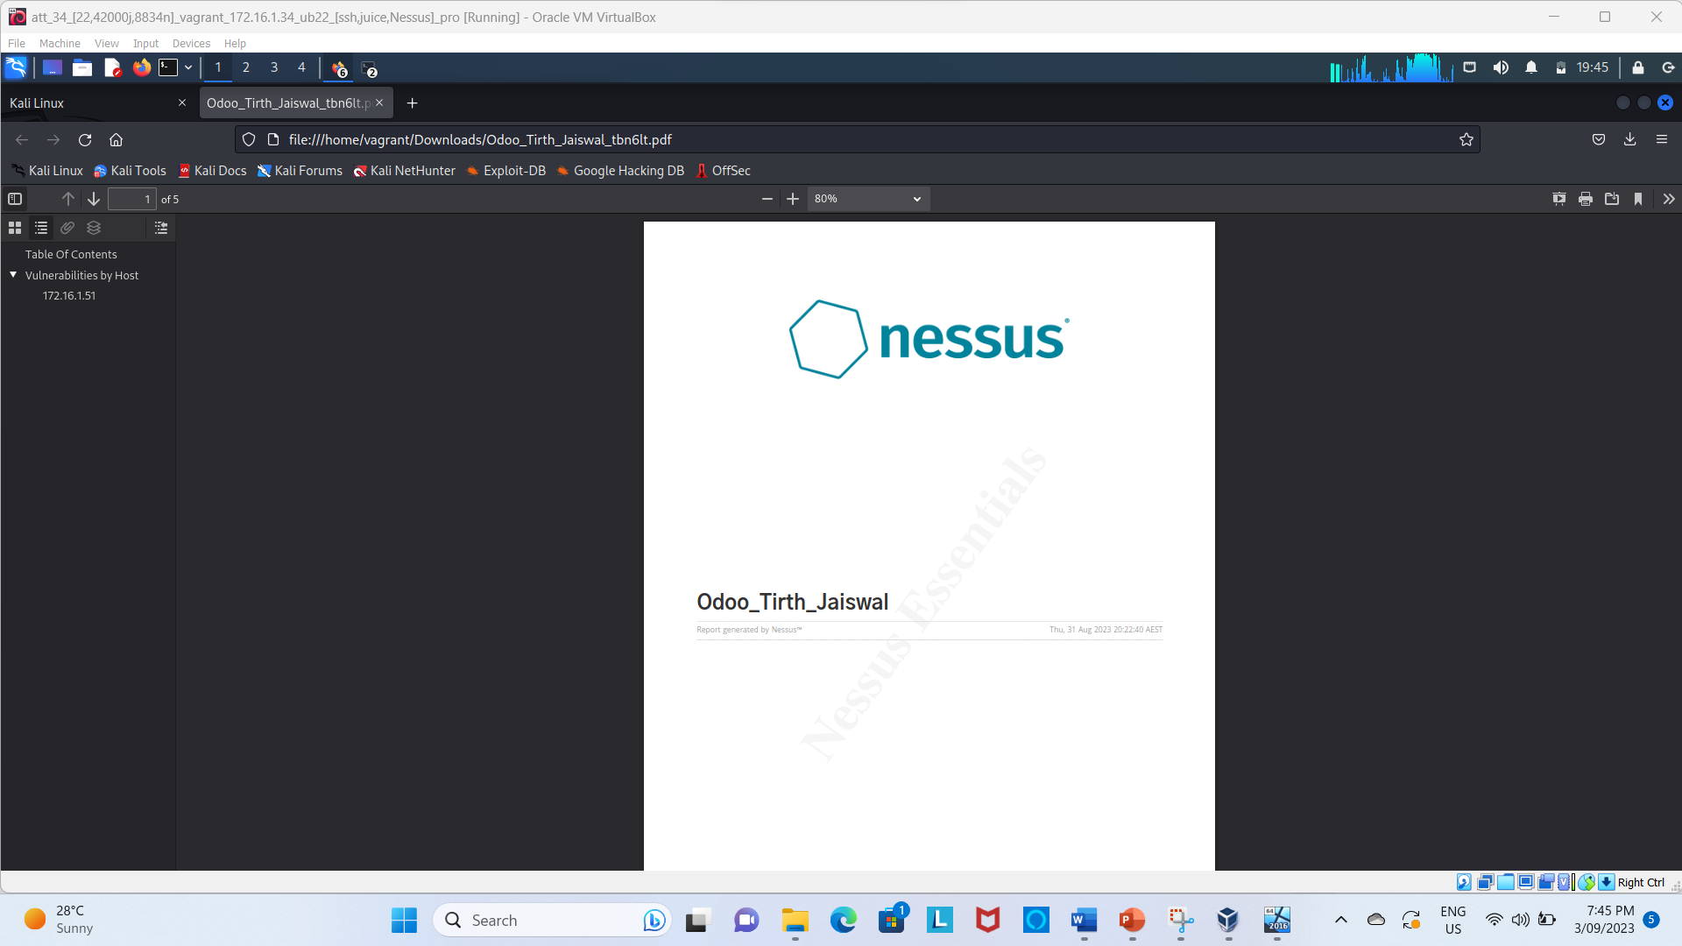
Searching Vulnerabilities without Wazuh: Nessus
I used Nessus scan to scan my windows and my odoo machine.
The reports will be submitted to moddle with this file.
Many minor and major vulns were found in the reports.

Slide 8
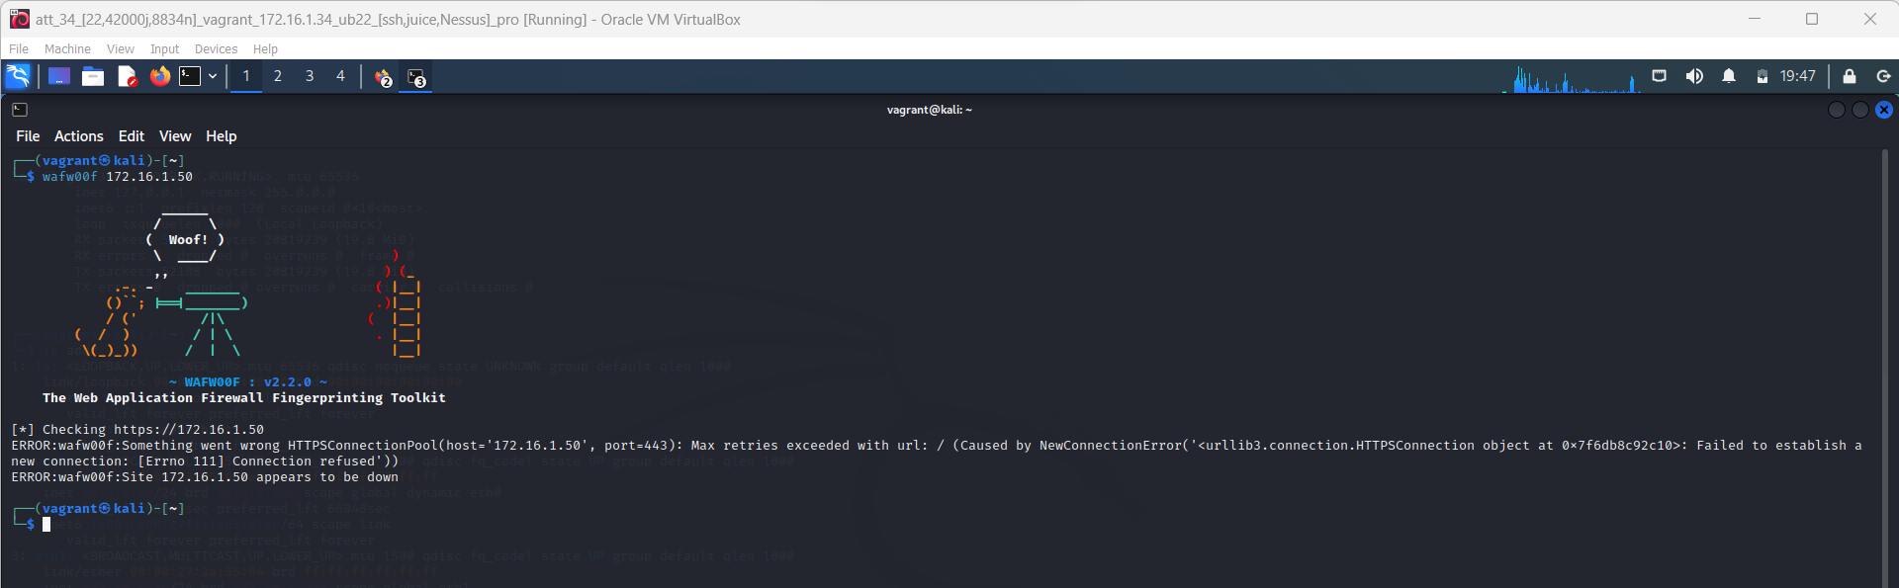
Wafoof Scan Screenshots for Win 11 VM
The following output occurs which was discussed with tutor and approved.

Slide 9
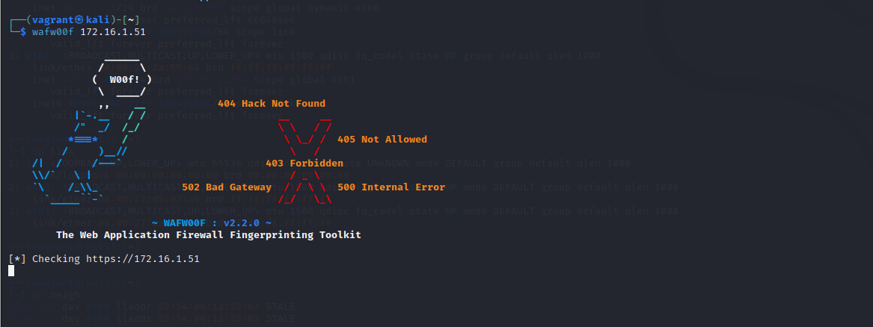
Wafoof Scan for Odoo

Slide 10
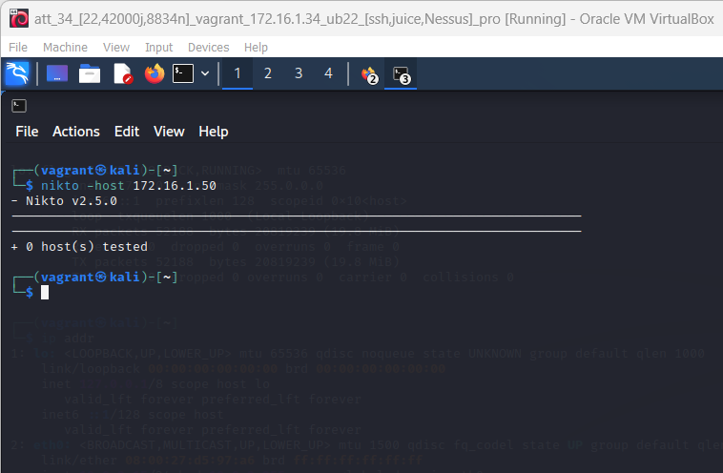
Nikto Scan for Win 11 VM
Nikto scan was done for 172.16.1.50 and found no vulns. As the VMs were well connected and running, I asked tutor to advice me on the same and no major vulns were found using Nikto.

Slide 11
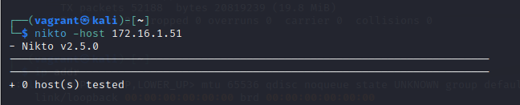
Nikto Scan for Odoo VM
I received the same output.

Slide 12
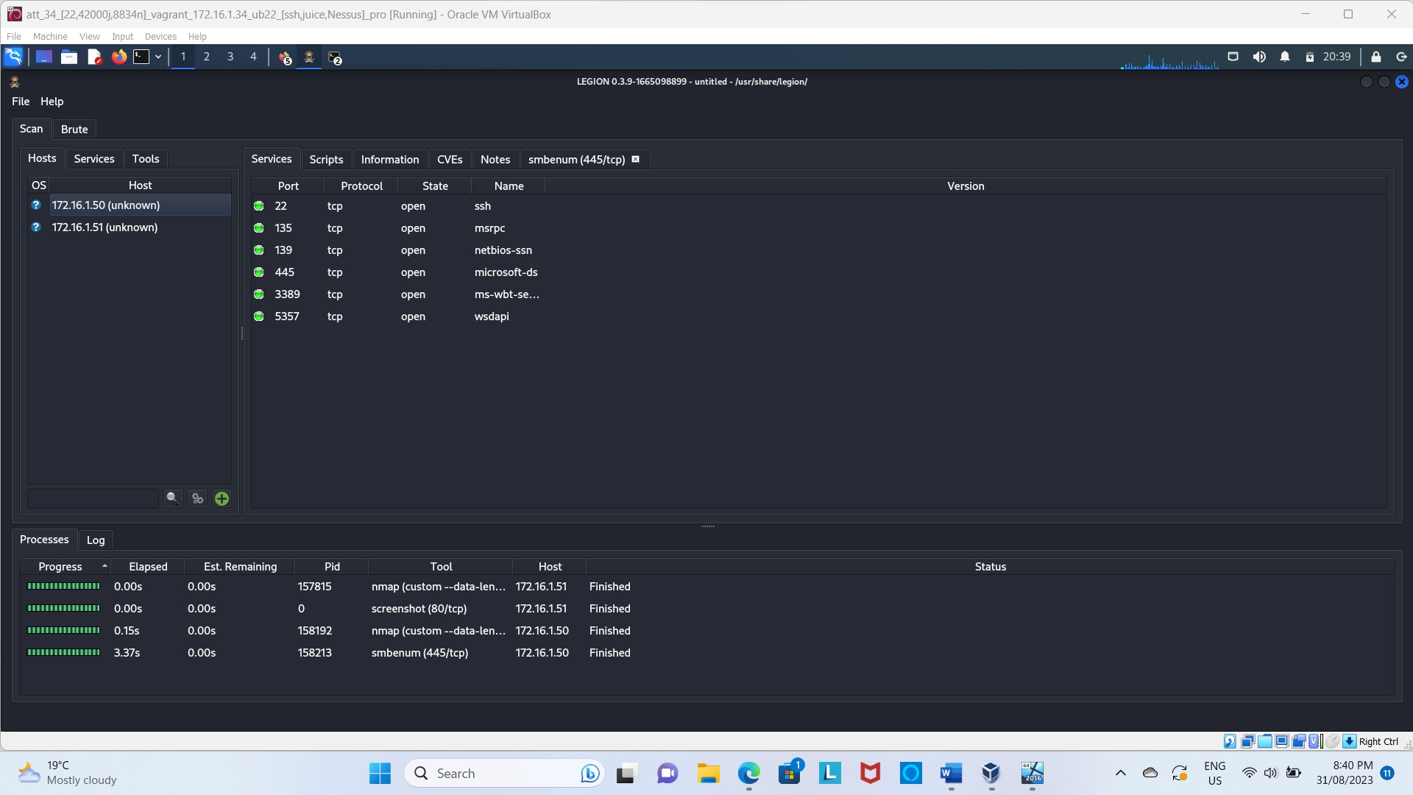
Scan with Legion
Scanned with legion was done for both the VMs, found some of the vulns but not as many as in the Nessus scan.
The files will be submitted in git for reference.

Slide 13
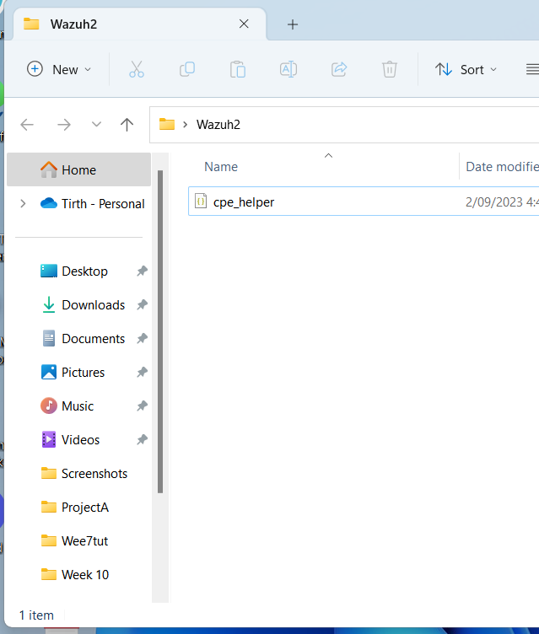
Copying cpe_helper.json folder in Wazuh
Using the following code I copied cpe_helper.json in host Wazuh2 file:
Sudo cp /var/ossec/queue/vulnerabilities/dictionaries/cpe_helper.json /media/sf_Wazuh2

Slide 14
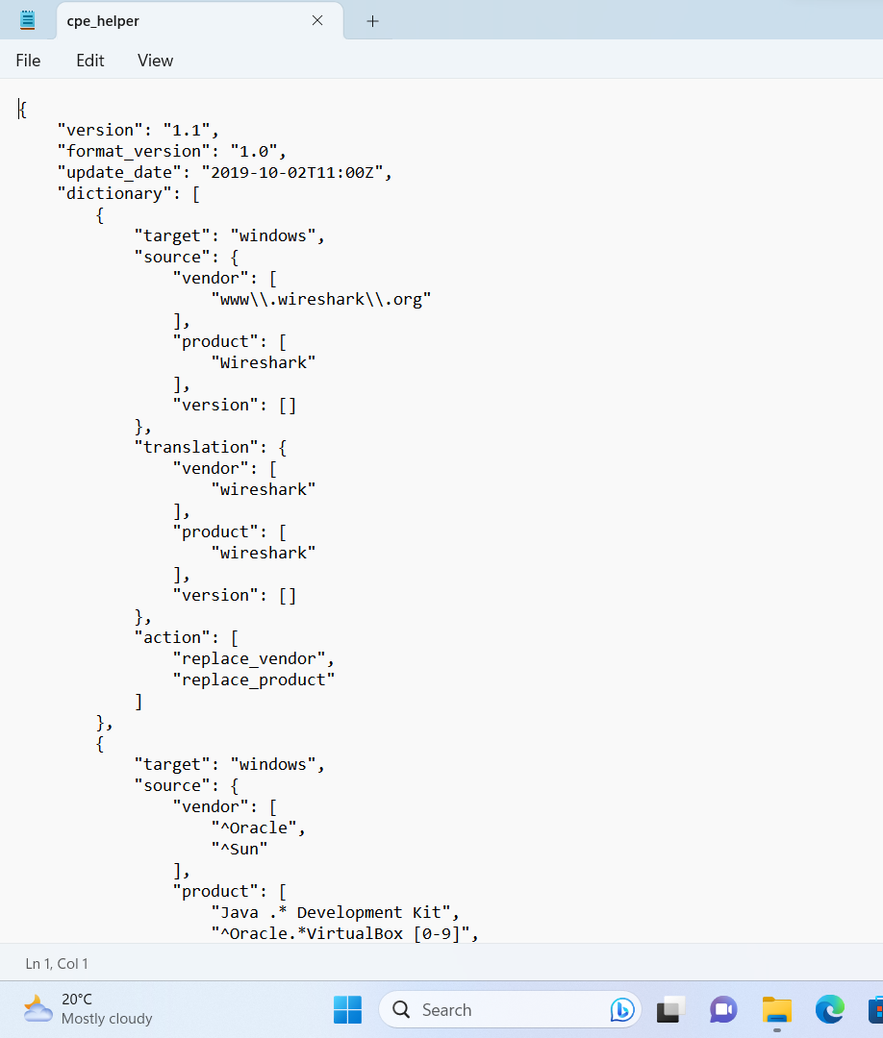
Opening the file
This code comes on the screen when opened with notepad.

Slide 15
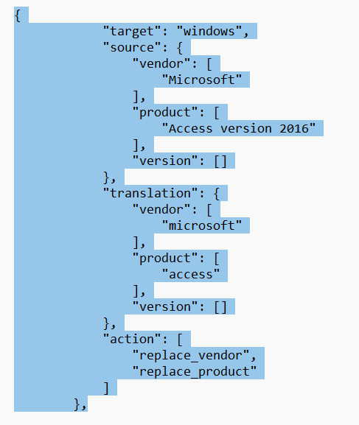
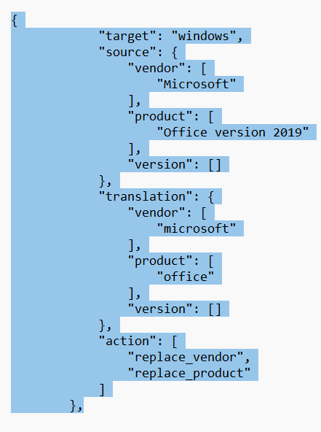
Amending the following part in the file:
I have added for both of my files:
Office version 2019
Access version 2016

Slide 16
Copying Back
I copied the cpe_helper file back to wazuh using the following command:
Sudo cp /media/sf_Wazuh2/cpe_helper.json /var/ossec/vulnerabilities/dictionaries/
And I used sudo reboot to restart the whole machine again.

Slide 17
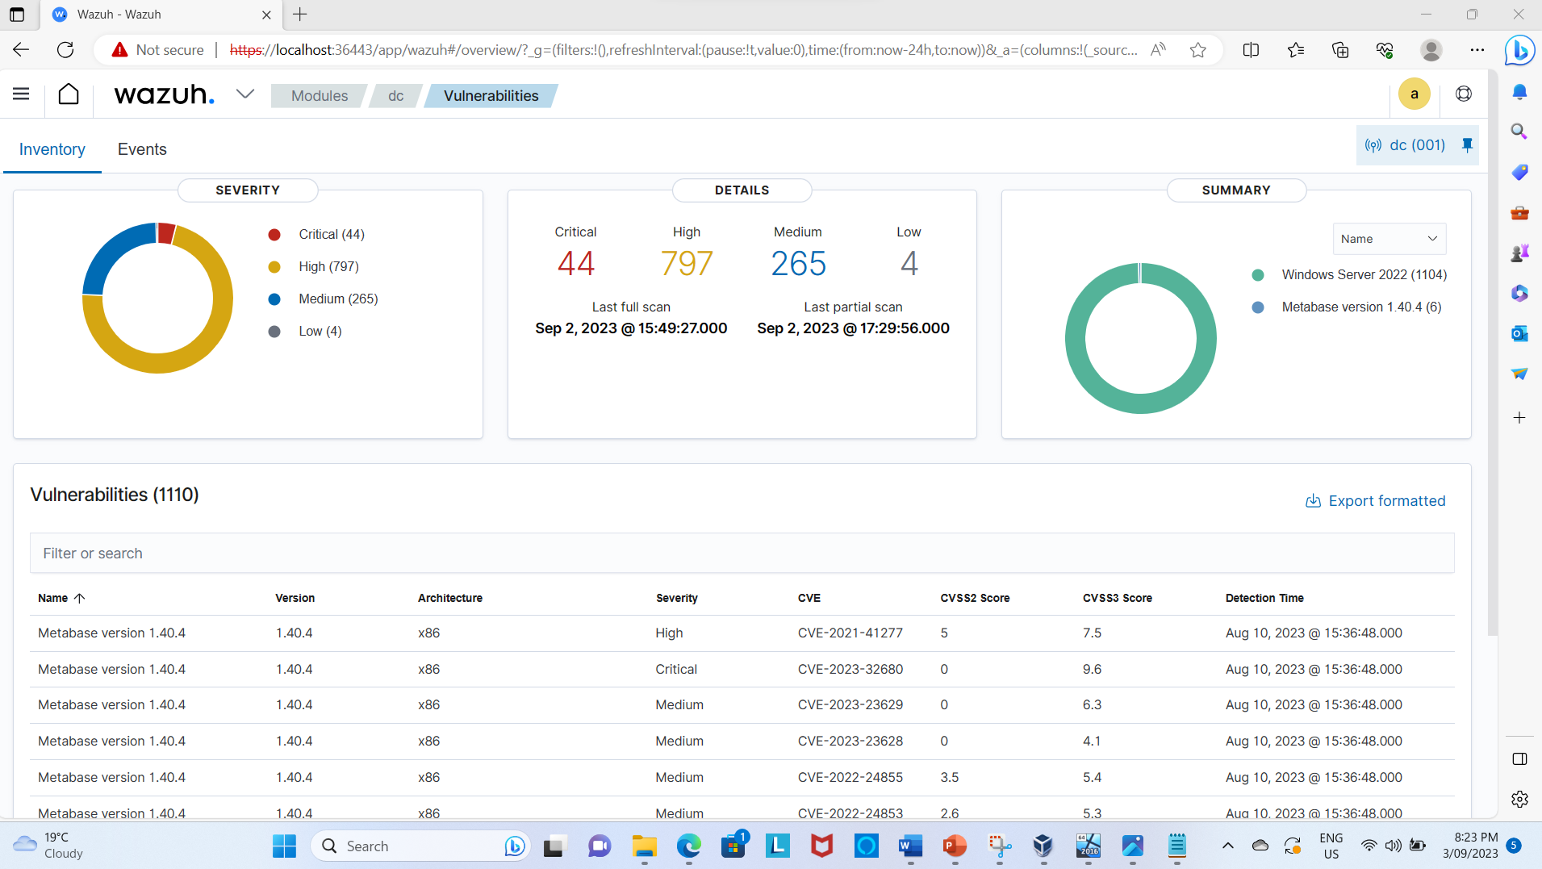
Screenshot before restarting the Wazuh
Intotal vulnerabilities found:
Critical: 44
High: 797
Medium: 265
Low: 4

Slide 18
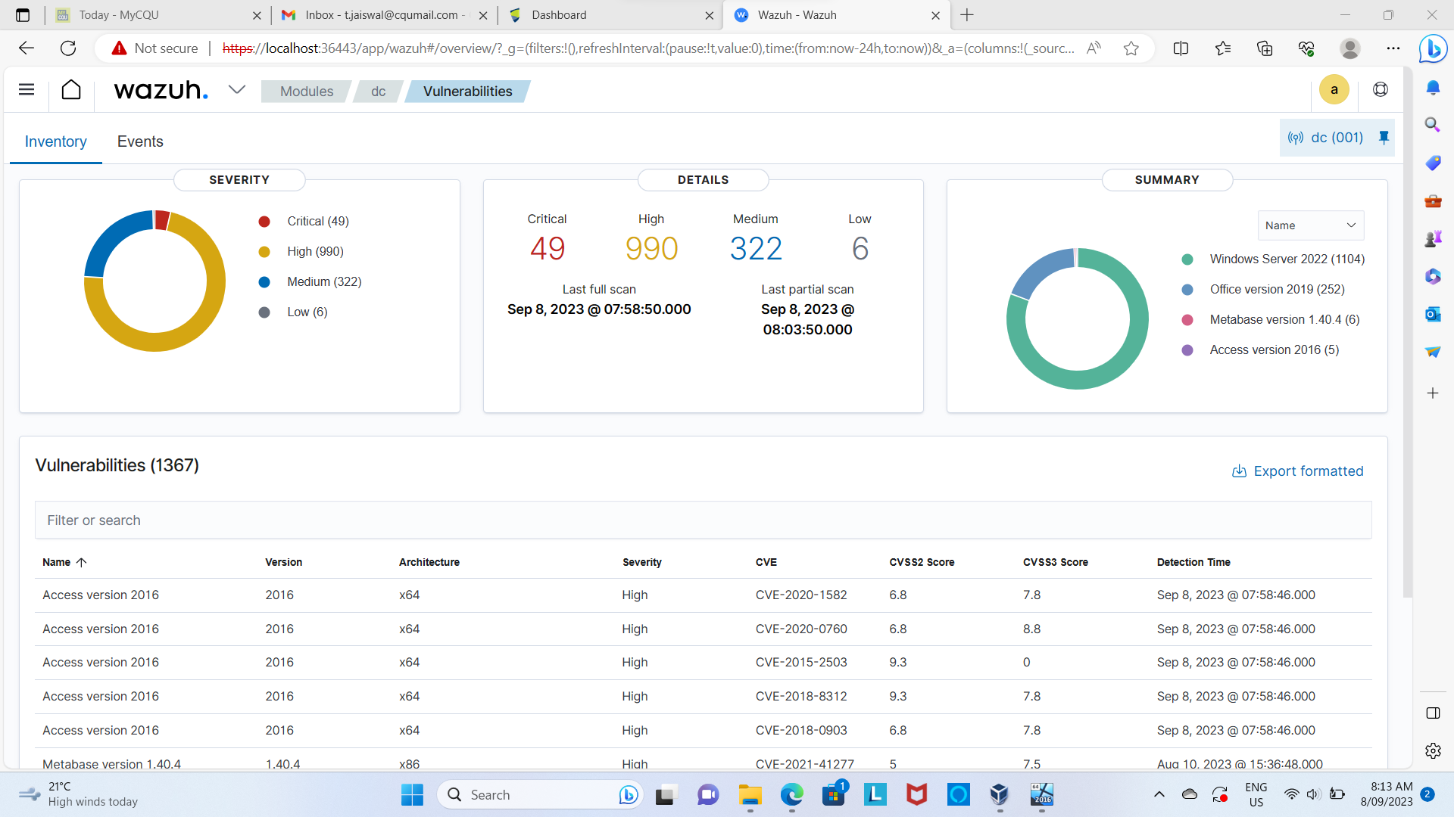
Screenshot after the next scan:
If we can see, there are increased vulnerabilities, hence, our wazuh caught some more vulnerabilities.
Technical difficulty faced:
At first, after rebooting my vulnerabilities didn’t change, but after rebooting and using command to force a scan “sudo bash triggerScan.sh” the vulnerabilities started increasing.
This increase in vulnerabilities are caused by:
Access version 2016
Office version 2019

Slide 19

Priortising the vulnerabilities
Definition: It is a process of assessing the vulnerabilities and ranking them according to the business threats.

Slide 20
Techniques used by Blackcat
Before jumping into directly prioritising the vulns, it is important for us to understand which techniques are used by blackcat:
T1548
T1134
T1087
T1059
T1486
T1491
T1561
8. T1083
9. T1222
10. T1070
11. T1490
12. T1570
13. T1112
14. T1135
15. T1069
16. T1018
17. T1489
T1082
T1033
T1047

Slide 21
Let find our first priority Vulnerability
CVE no. | CWE no. | CAPEC ID | Attack ID | Blackcat
CVE-2019-1109 | CWE-20 | CAPEC-104 | 1548 | YES
Description:
After going in wazuh and looking for a critical vulnerability, I found CVE-2019-1109.
I connected the CVE number to CWE number and traced the capec number, there were many capec ID available but after checking all the IDs, I found technique 1548 being used in CAPEC-104. This vulnerability does cross zone scripting it has parent capec which does privilege the escalation by using T1548.
Hence, this vulnerability should be prioritised to specifically be safe from BlackCat ransomware.

Slide 22
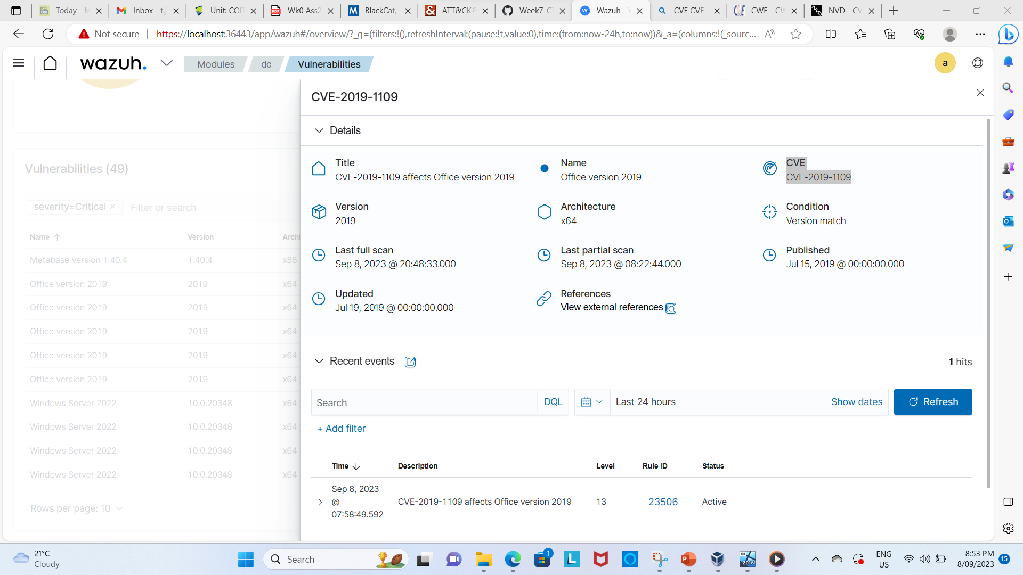
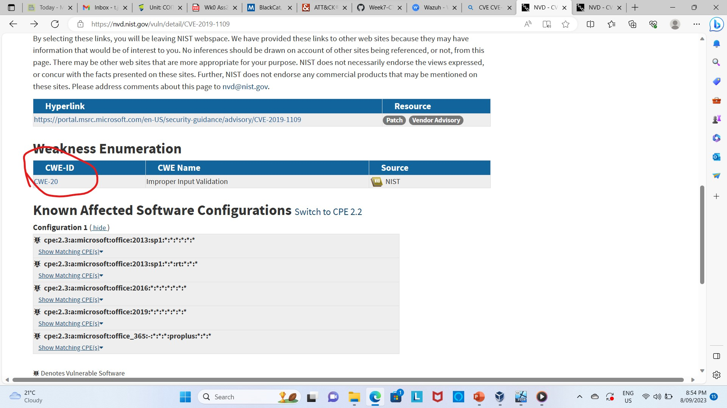
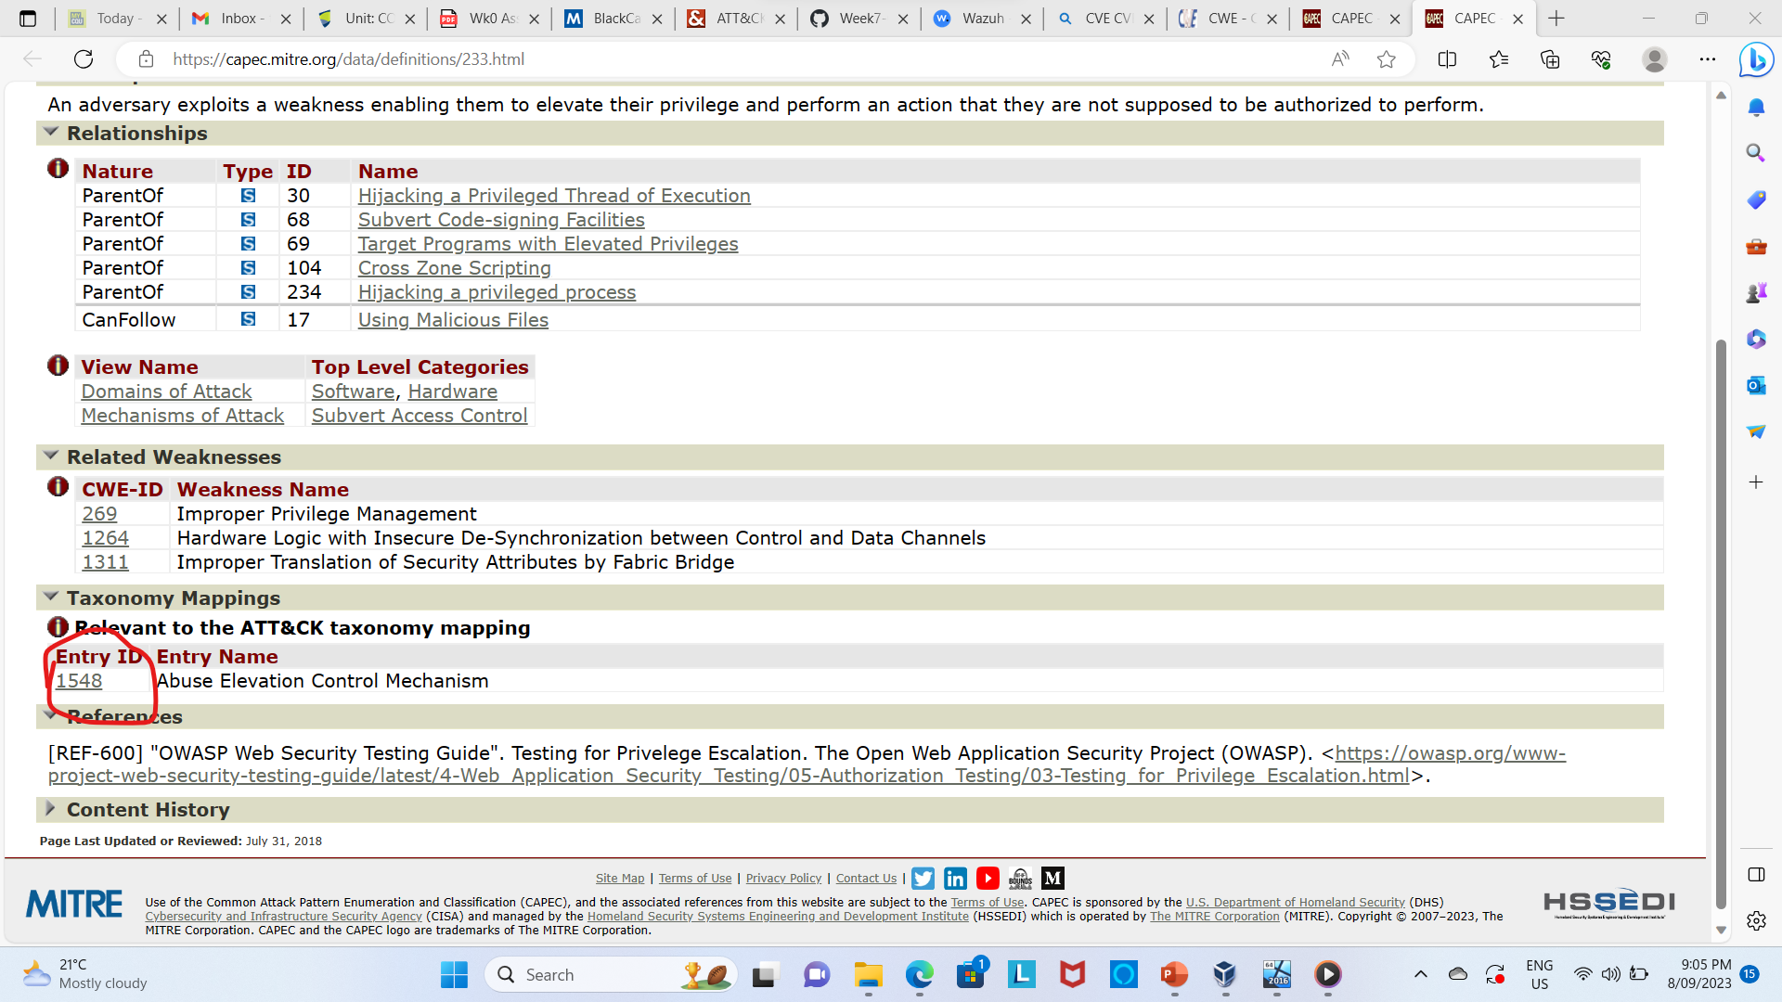
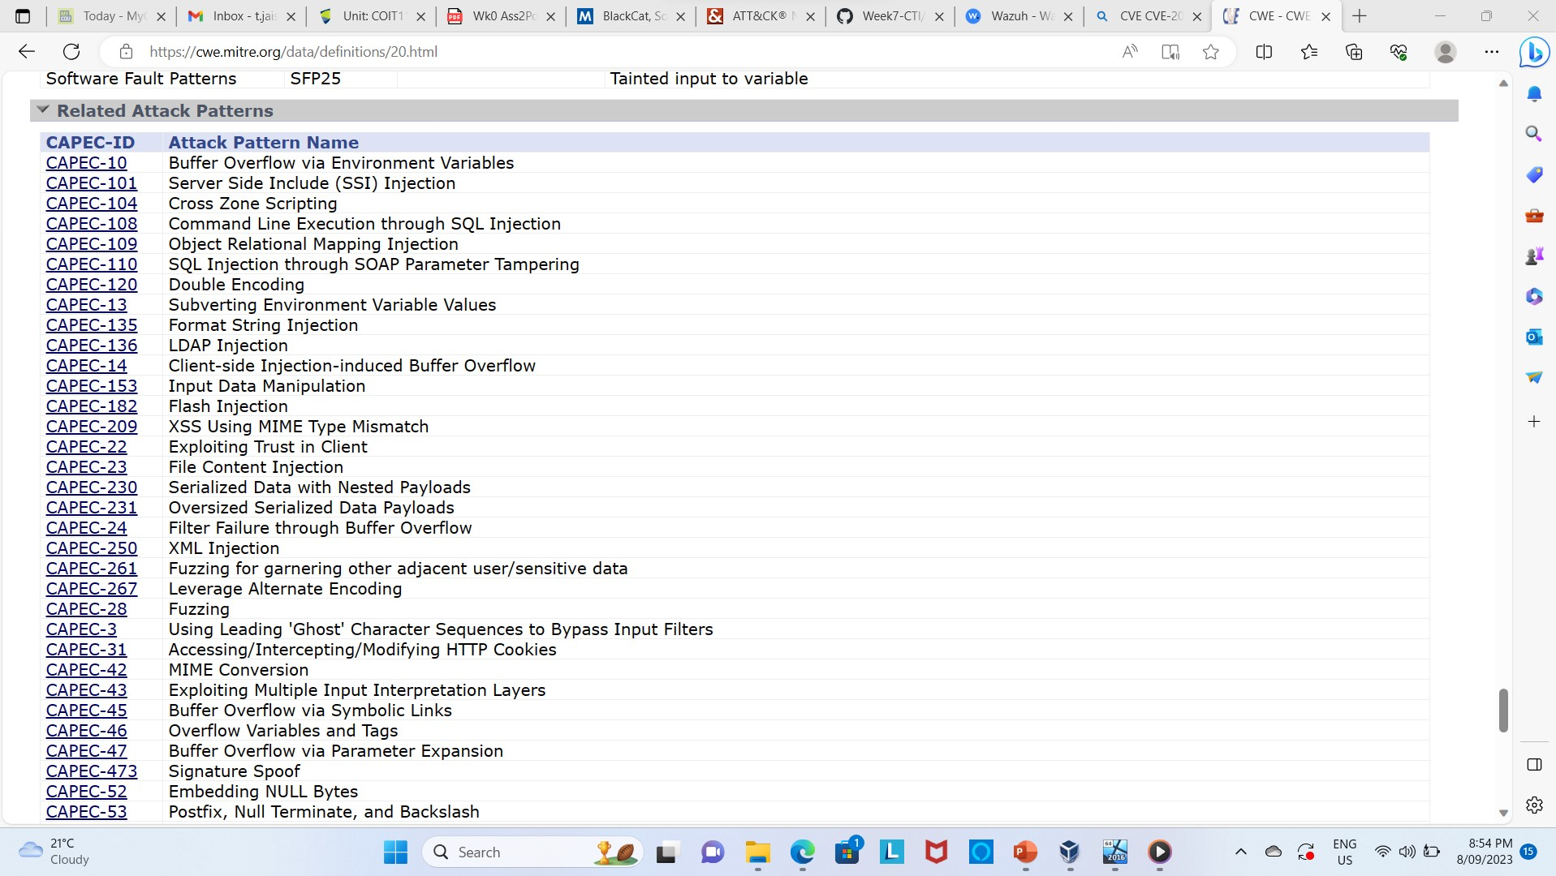
Proof for first priortization

Slide 23
Second vulnerability for prioritization
CVE | CWE | ATTACK ID | Black Cat
CVE-2020-16949 | CWE-401 | T1561 | Yes
Explanation: This CVE is taken from wazuh scan and if we trace it then the CWE results to be CWE-401.
Here, after reading careful information, which gives following information:
‘The product does not sufficiently track and release allocated memory after it has been used, which slowly consumes remaining memory.’
The above information matches with the characteristics of T1561, hence we can prioritise that vuln.

Slide 24
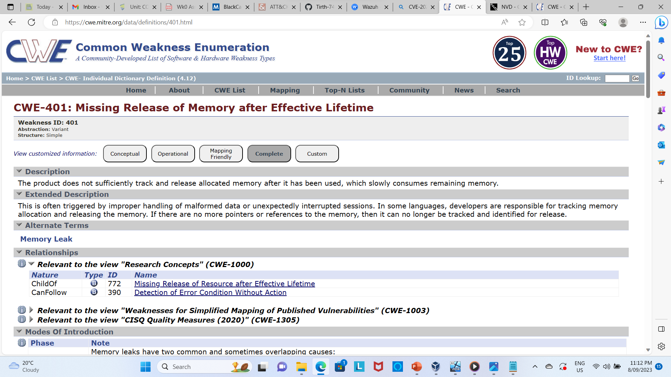
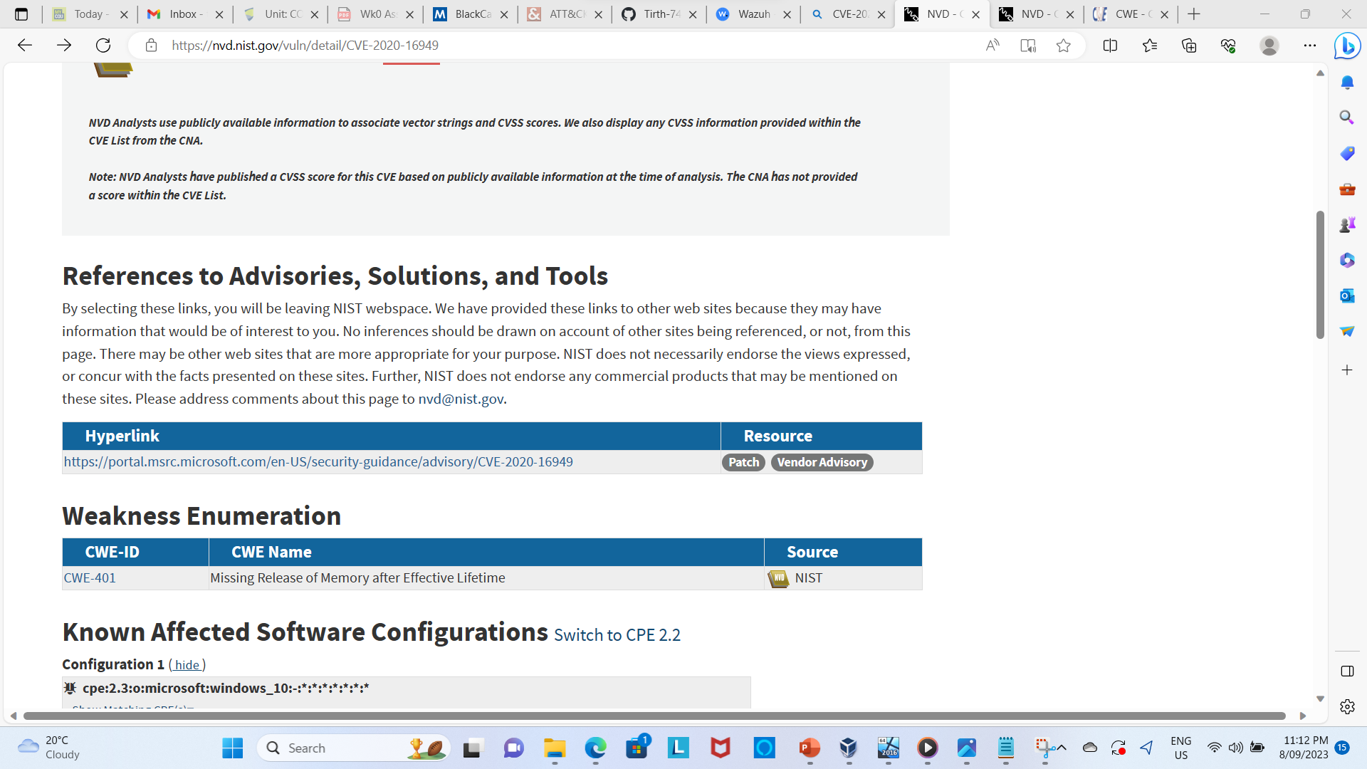
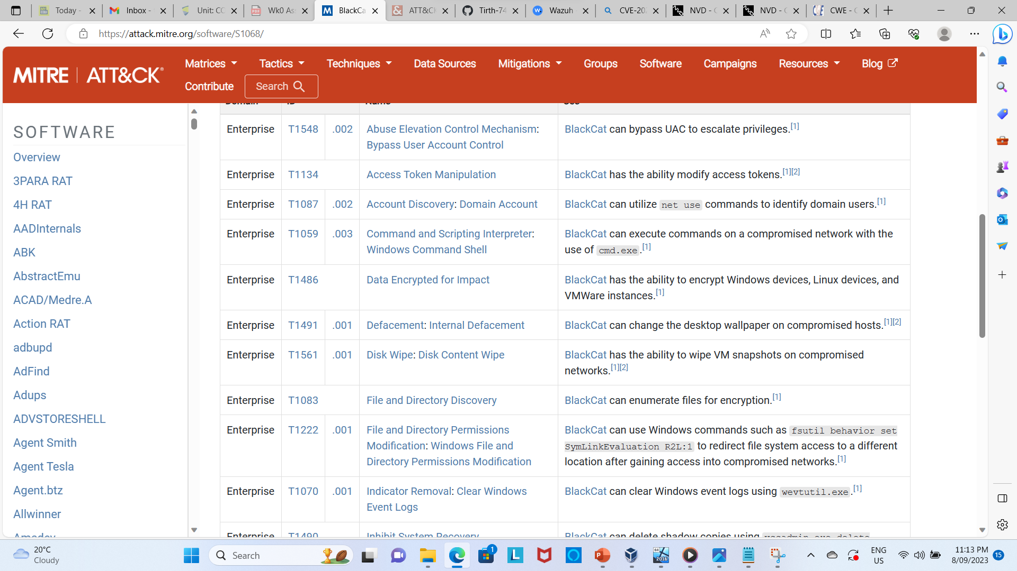
Proof of research for vuln no. 2

Slide 25
Third vulnerability for prioritization
CVE | CWE | CAPEC ID | ATTACK ID | BlackCat
CVE-2021-1711 | - | - | T1018 | Yes
The main reason for choosing this vulnerability is its relevancy of using technique and the CVVS2 score.
The CVSS2 score for this vuln is 9.3 which is considerably very high. Here, After reading the description of the CVE, I found insufficient information for CAPEC ID but according to information of NVD government website, this vulnerability gives the remote access and leads to leak in information, hence, after careful consideration, I found, attach technique T1018 is very similar to the technique used by this CVE, hence, it is very important to prioritize the vuln.

Slide 26
Prioritising vulnerability no. 4
CVE | CWE | CAPEC | ATTACK | BlackCat
CVE-2023-23629 | CWE-269 | CAPEC-122: Privilege Abuse | T1548 | Yes
Explanation: I found this vulnerabilities in medium category but this can be easily escalated by blackcat ransomware. We can trace CVE-2023-23629 to CWE-269 and this CWE is further traced to CAPEC id number 122. This CAPEC states that this vulnerability can be easily used to escalate the administrative privileges using technique T1548 which also a major source of blackcat ransomware.(capec.mitre.org, 2023)

Slide 27
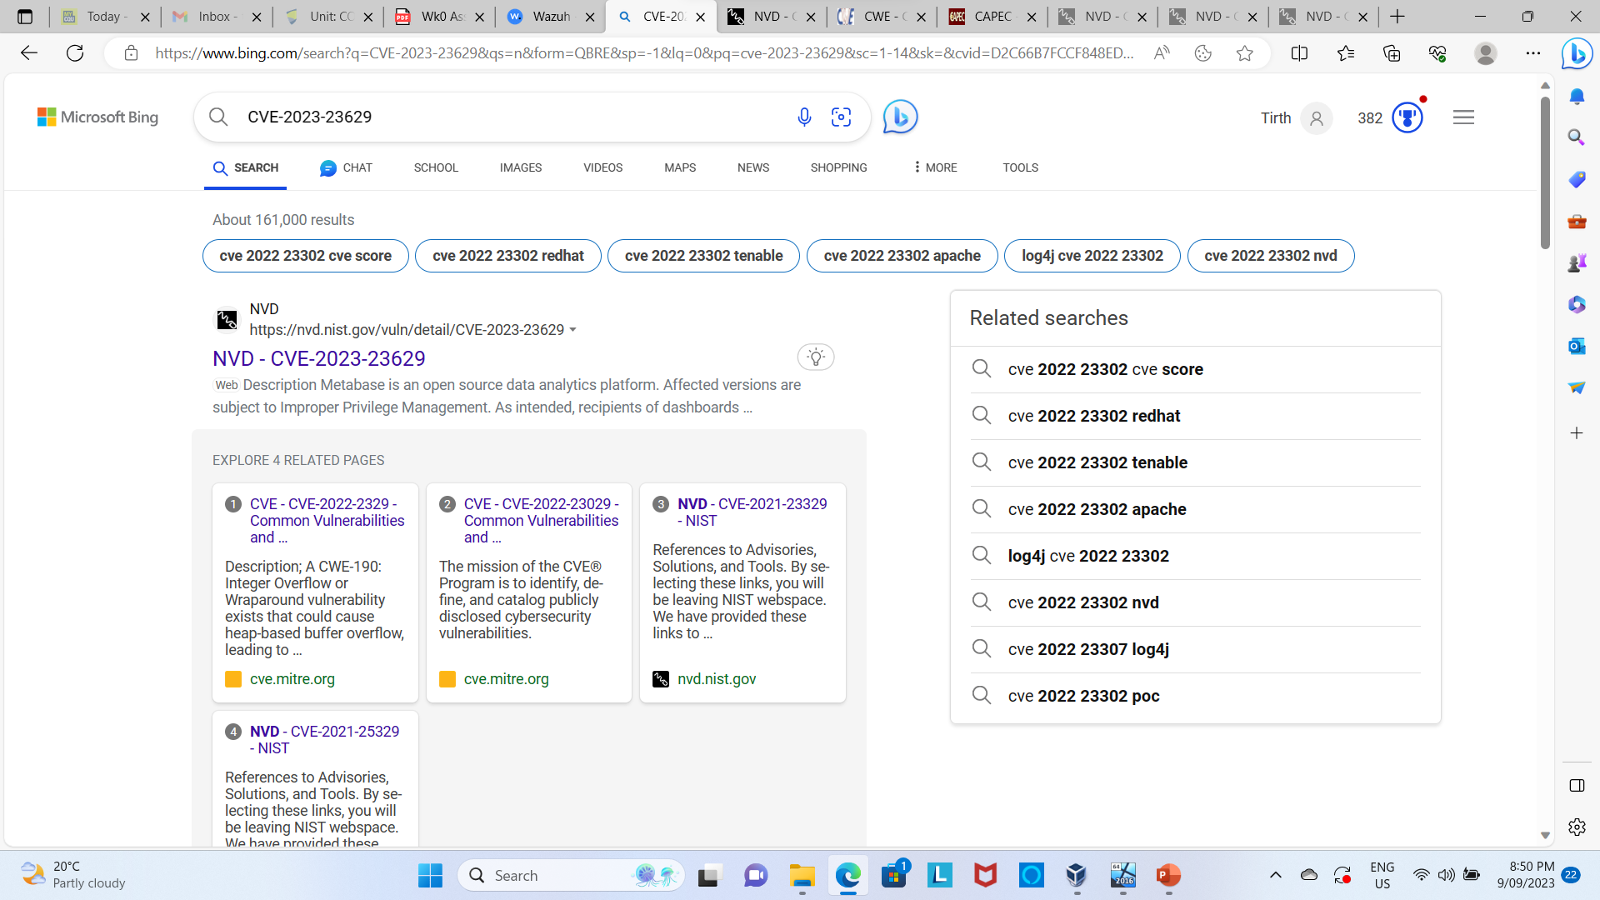
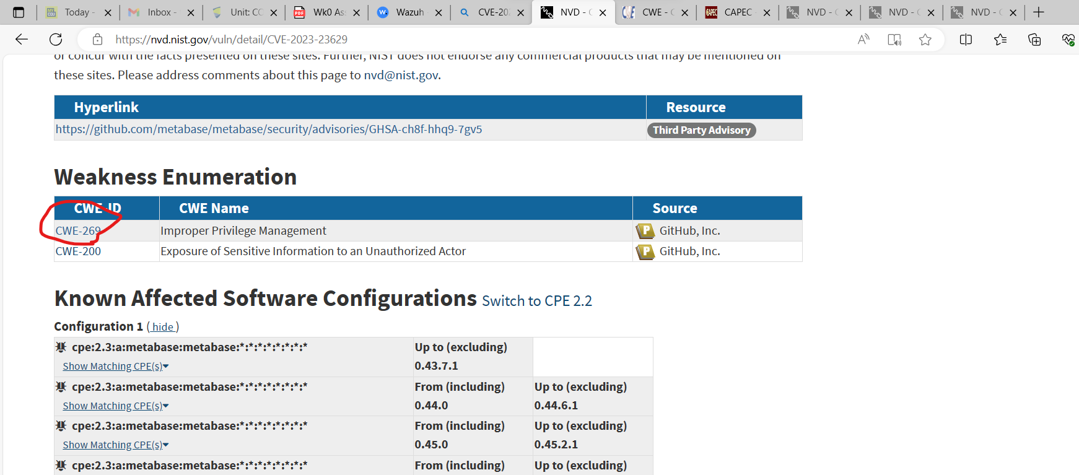
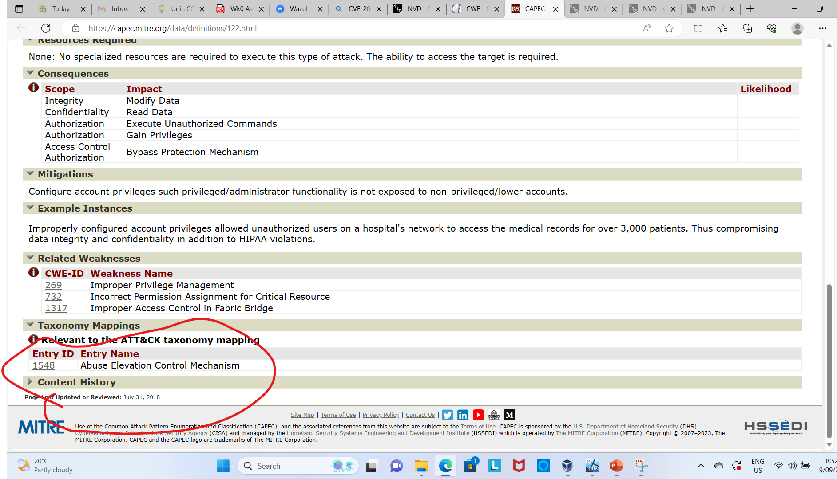
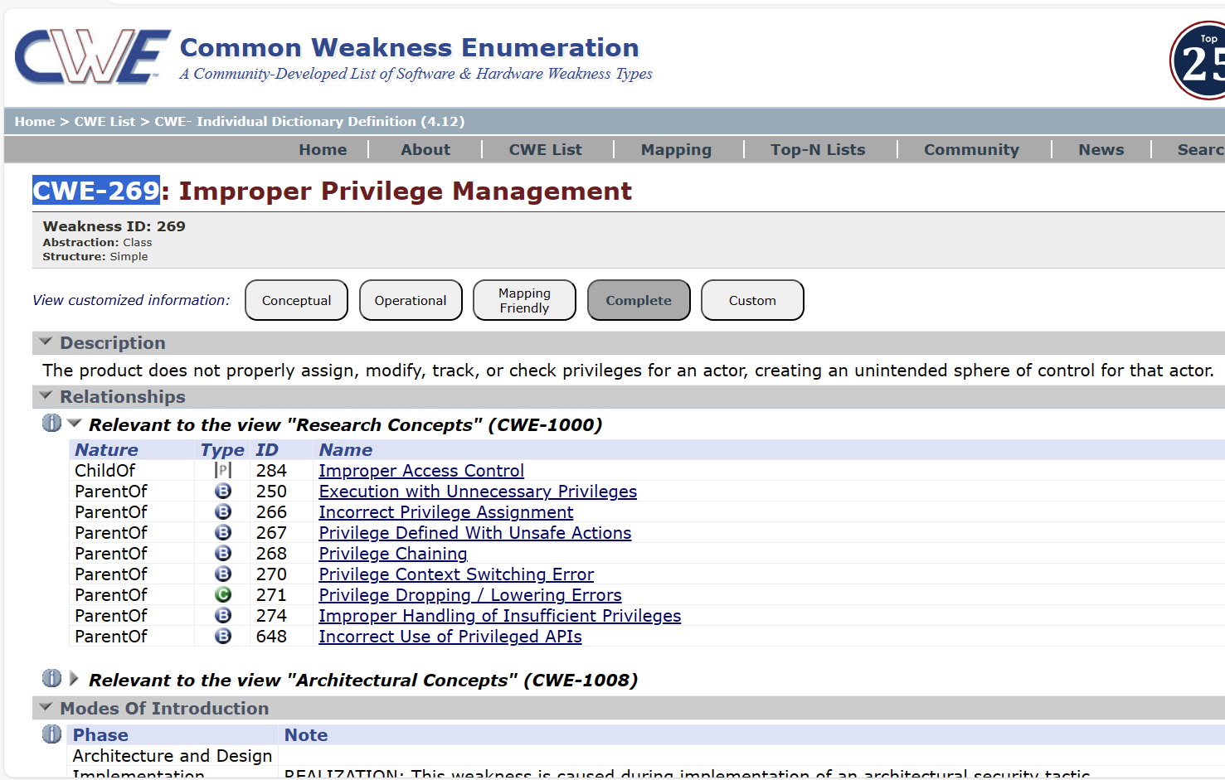
Proof of research for no. 4

Slide 28
Prioritising vulnerability no.5
CVE | CWE | CAPEC | ATTACK | BlackCat
CVE-2019-1446 | CWE-200: Exposure of Sensitive Information to an Unauthorized Actor | CAPEC-576: Group Permission Footprinting | T1069 | Yes
Explanation: The score of this vuln is 5.5 but there is a major threat of attacked by BlackCat ransomware. The CVE found in the wazuh scan no. 2019-1446 can be traced to CWE-200 that further traces to CAPEC-576. If we further go in detail, this vuln can be exploited by attack T1069 which is one of the tactics used by blackcat ransomware. Hence, this vulnerability must be addressed as soon as possible.

Slide 29
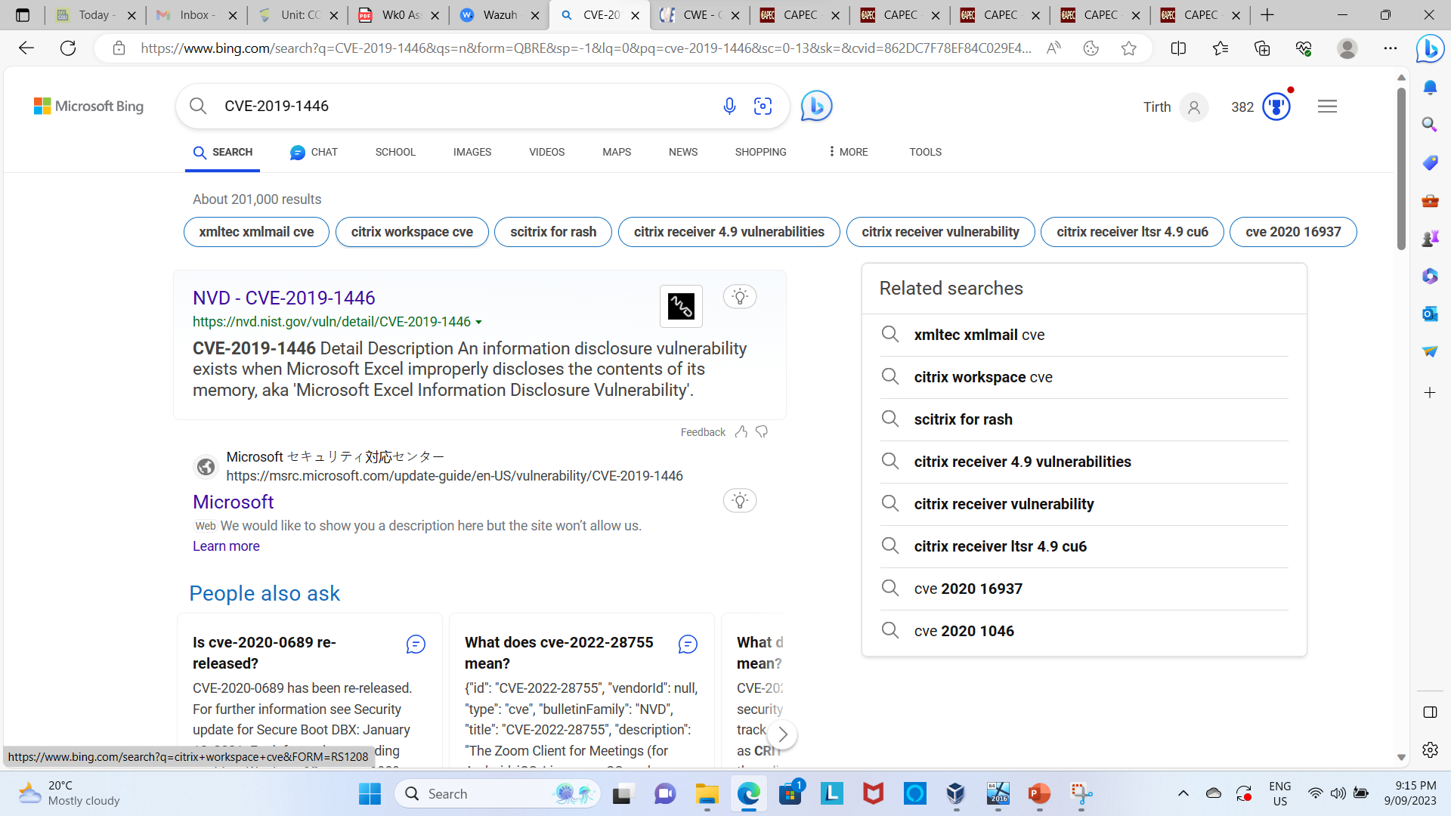
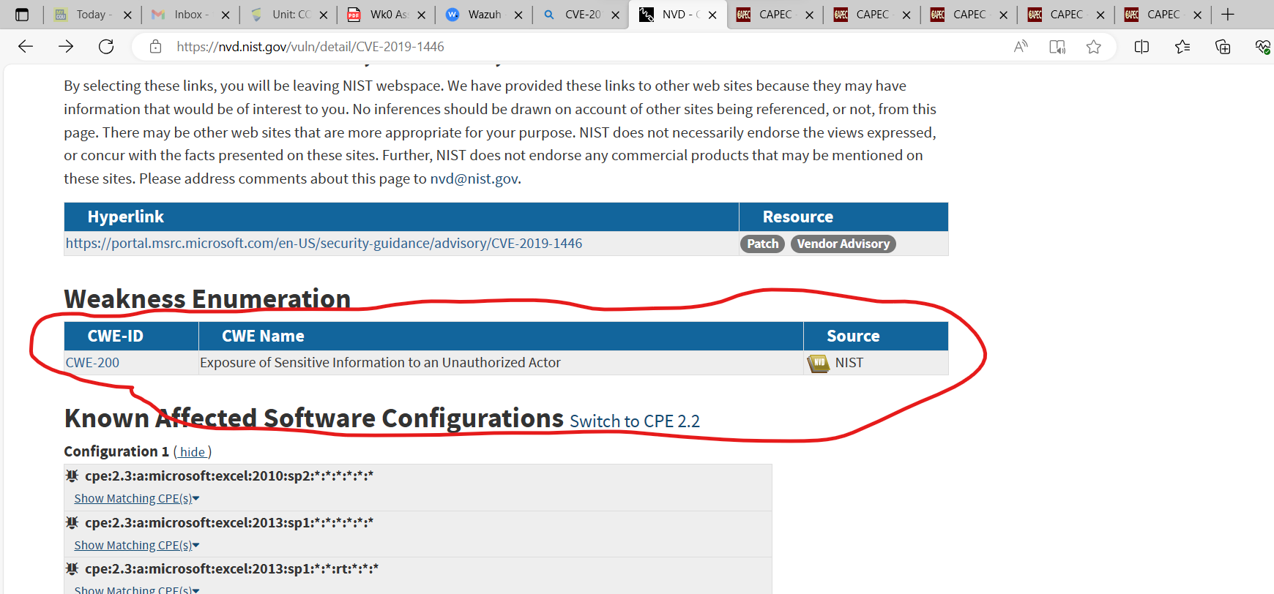
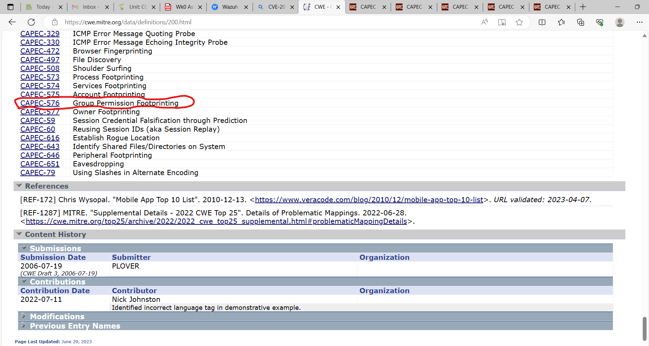
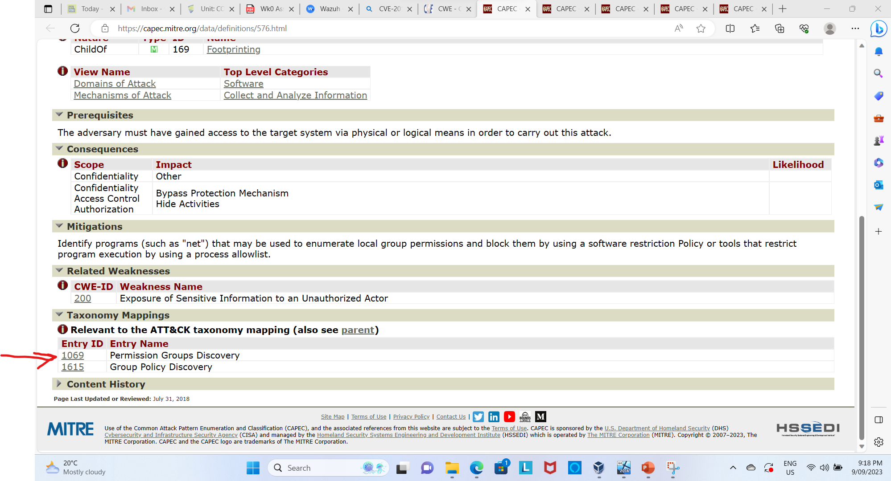
Proof research for no. 5

Slide 30
References
Heimdal, How to Prioritize Vulnerabilities Effectively: Vulnerability Prioritization Explained by CRISTIAN NEAGU, viewed 8th September, How to Prioritize Vulnerabilities Effectively: Vulnerability Prioritization Explained (heimdalsecurity.com)
MITRE, Common Weakness Enumeration, viewed 7th September, https://cwe.mitre.org/data/definitions/200.html
MITRE, Common Attack Pattern Enumeration and Classification, viewed 7th September, https://capec.mitre.org/data/definitions/576.html
NIST, National Vulnerability Database, viewed 7th September, https://nvd.nist.gov/vuln/detail/CVE-2019-1446

